Slide 1
Disaster Alley
Team 7446

Slide 2
Origin of the idea:
The origin of this game is two fold, for one, we knew that in Infinite Recharge, a meteor was heading towards first city, so of course after the meteor bounces off, it has to do something. Secondly, our team is from Northern Alabama which is pretty notorious for tornadoes, so from there we started thinking about other disasters and it morphed into the game idea we have now.

Slide 3
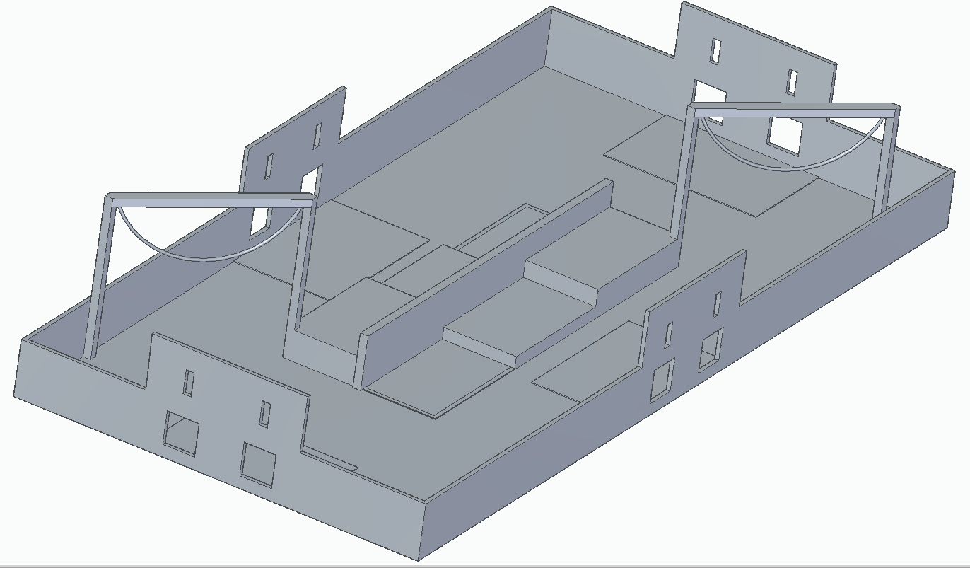
Game Overview
Robots from each team move from the starting line and get reinforcements from the stockpiles around the map. These reinforcements are then put in their slots that correspond with the elements of the disaster at hand. Before each disaster, teams can pull the chains near the center of the map to trigger a siren. When the final disaster is finished, the robots move up the platforms at the center of the map to gain the high ground.

Slide 4
Lore
The meteor which almost destroyed FIRST city was deflected by the city’s shield, weakening it in the process.
The meteor crashed not far from FIRST city, causing a disruption to the planet’s ecosystem.
Many fierce natural disasters are expected to devaste FIRST city, now left vulnerable without its shield. It is up to its inhabitants once again to save FIRST city.
They must fortify key locations according to which natural disaster is predicted.
The fate of FIRST city is in their hands.

Slide 5
Interesting Mechanics
A rectangular prism acts as the reinforcements against the disasters, and can be found in the stockpiles. These reinforcements are put into slots with the corresponding elements of the disasters. The chain is used as a siren that can be pulled before every disaster for a score multiplier.

Slide 6
Element
In our game, the chain is used as a method of activating “Emergency Sirens” which allow teams to have a score multiplier for the current disaster. The chain can also be pulled during autonomous for a score multiplier during that time. The multipliers do not stack.

